Slide 1

Final project Presentation
Rich Fox
ITAI 1371

Slide 2
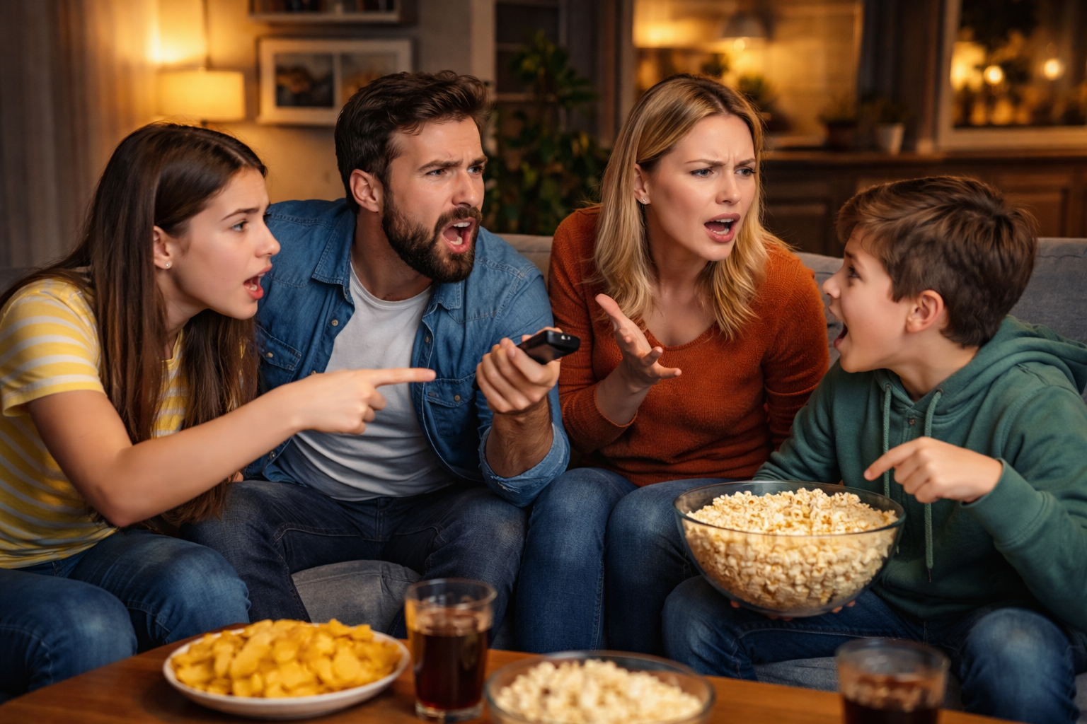
motivation
Every year, there are countless arguments around the coffee table about what movies should be watched. Trying to navigate through the unlimited supply of movies to find something good to watch is frustrating and time consuming. This has driven a wedge through many families, even possible resulting in divorces and alienated children. Something must be done!

Slide 3
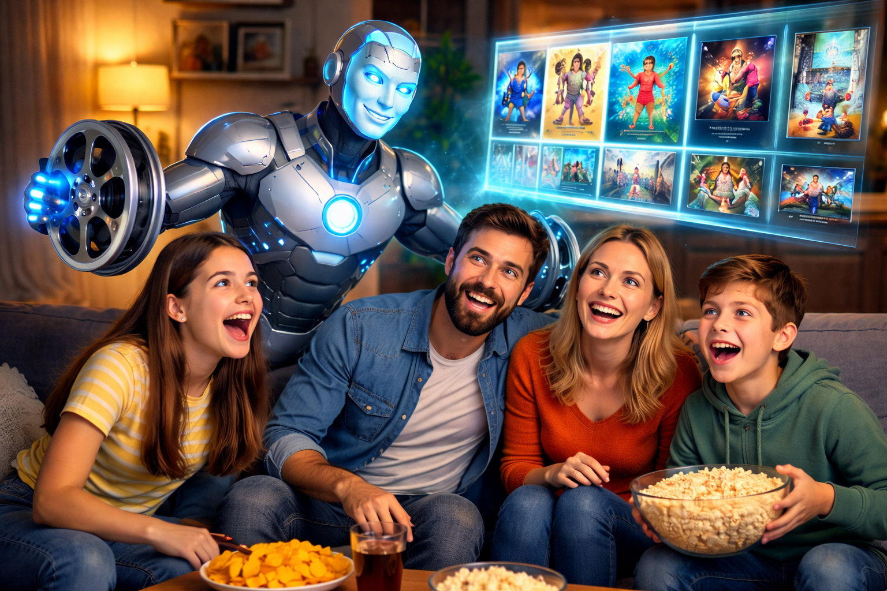
introduction
Families need a better way to select what movies that they are going to watch. Randomly clicking on a movie jut doesn’t work, time is too precious to just watch any old movie. Someone should really create a process that will help families select what movies to watch to end the chaos.
That’s why I am creating a process to recommend movies to watch based on a movie that was enjoyed!

Slide 4
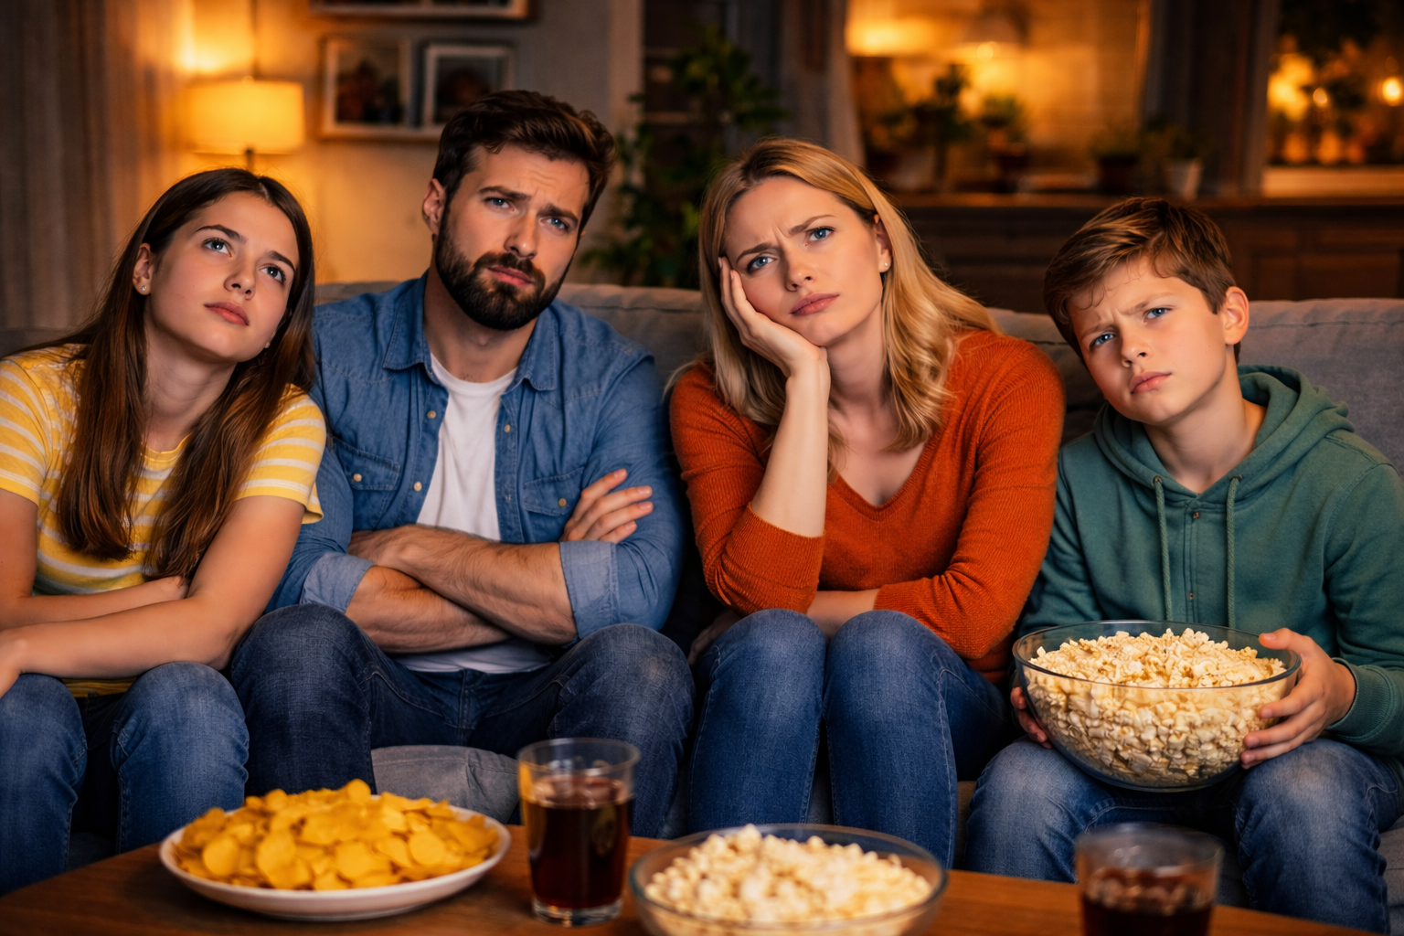
background
Recommendation systems have become a core component of modern entertainment platforms, helping users navigate vast libraries of content by predicting their preferences. The primary challenge these systems address is accurately recommending movies or shows that align with individual user tastes based on past behavior. Traditional approaches include collaborative filtering, which identifies patterns among similar users, and content-based filtering, which recommends items with similar attributes to those a user has liked before.

Slide 5
background
More advanced, state-of-the-art methods use matrix factorization techniques such as Singular Value Decomposition (SVD) and hybrid models that combine multiple approaches to improve accuracy and robustness. Major companies like Netflix, Amazon, and Spotify rely heavily on these systems, demonstrating their effectiveness in increasing user engagement and satisfaction.

Slide 6
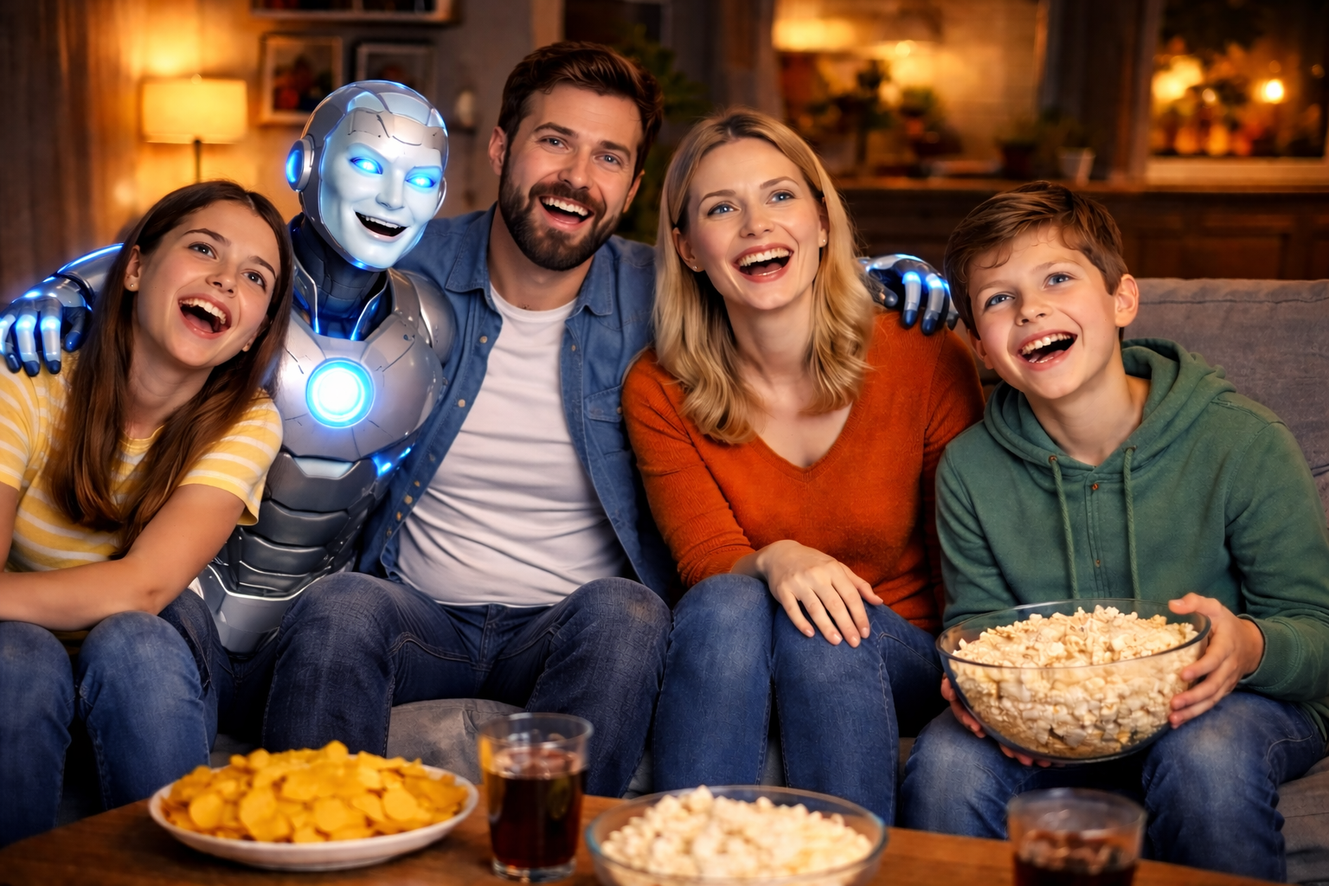
methods
In order to bring peace and happiness to families all over the world, I have created a process to assist on their next movie selection!
My process is using a hybrid approach with three similarity methods to analyze user ratings and genre tags to create user recommendations.

Slide 7
methods
NHH Score It looks at the raw rating data, who gave what score to which movie, and finds movies with similar rating patterns.
SVD Score
SVD has already compressed all the rating data down into a small set of hidden dimensions. Each movie becomes a point in that space. This function measures how close two points are. It's more nuanced than KNN because it's working from those learned dimensions rather than raw ratings.
Genre Score It looks at the genre tags (Animation, Comedy, Adventure, etc.) and uses a formula called Jaccard similarity, basically: shared genres ÷ total genres combined. Two movies sharing 3 out of 4 genres score much higher than two movies sharing 1 out of 8.

Slide 8
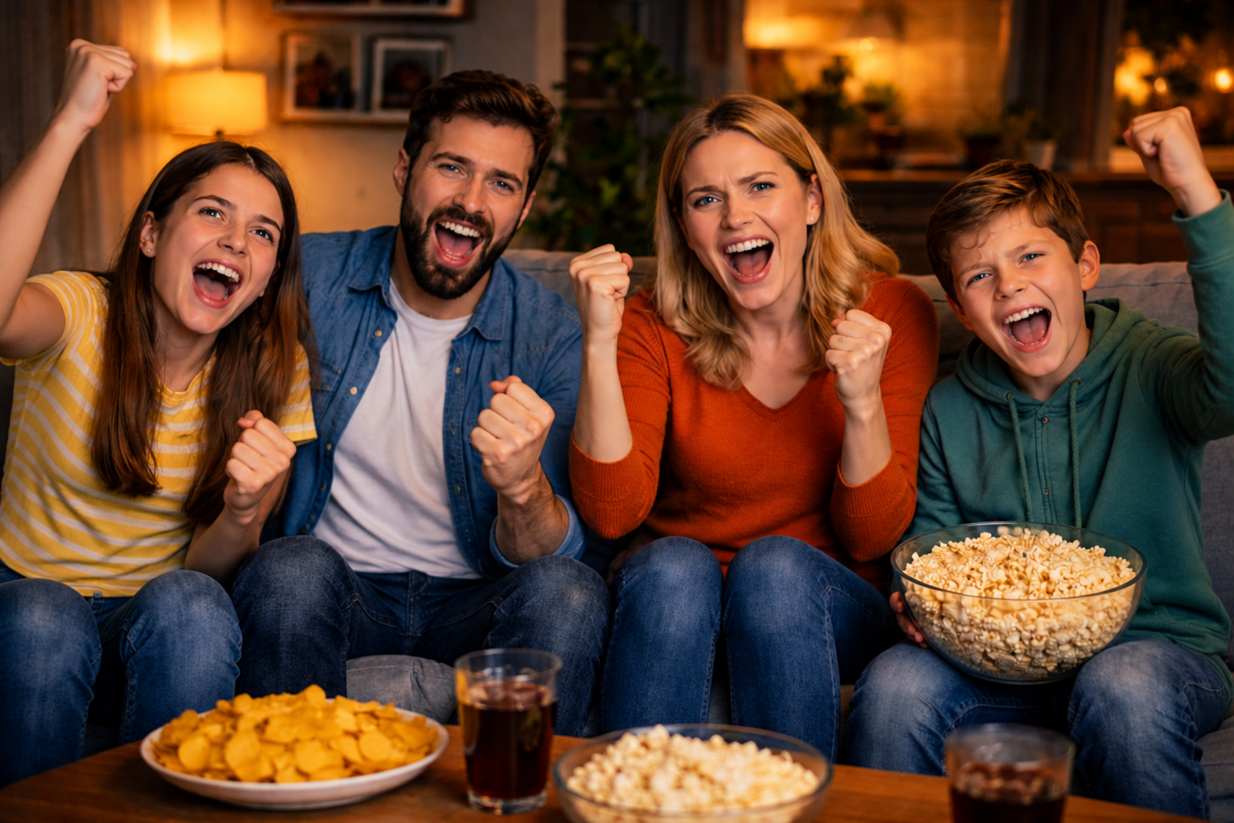
methods
Why is this going to work?
Each method has a blind spot. KNN can be thrown off by users with unusual taste. SVD can be abstract and miss obvious genre matches. Genre matching alone is too shallow, lots of movies share genres without being similar. Combining all three makes the recommendations more robust than any single method alone, which is the same reason Netflix, Spotify, and Amazon use hybrid approaches in production.

Slide 9
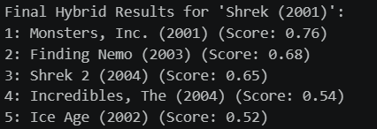
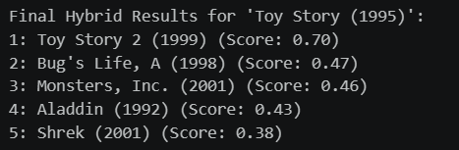
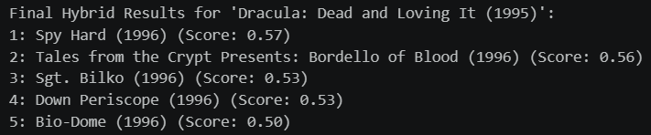
results

Slide 10
discussion
Memory Issues
The Memory Error is happening because Pandas is trying to create a massive "dense" matrix. The dataset has about 84,000 movies and 200,000 users—multiplying those together creates a table with 16.9 billion cells. At 8 bytes per cell, that requires 126 GB of RAM, which is why the computer crashed. To fix this, I need to filter out the "noise" (movies and users with very few ratings) and use a Sparse Matrix that only stores the actual ratings, not the zeros
Individual Models Preformed Poorly
I developed a hybrid ensemble that combined Collaborative Filtering, SVD, and Content-Based models to overcome the limitations of each individual algorithm. This approach allowed the strengths of one model to cover the 'blind spots' of the others, resulting in significantly more accurate and diverse recommendations.

Slide 11

Future directions
Tune the Hybrid Weights
The 0.4/0.4/0.2 split is currently a guess. Running a simple grid search over weight combinations using existing evaluation functions would back up those numbers with data.
Creating a User Interface
Currently this is a notebook only solution. Adding a couple prompts and some user interaction would make this a lot more user friendly.

Slide 12

conclusion
As a long fan of movies and someone always looking for something new to watch, this was a fun project to work on.
Creating a pipeline that is using KNN and SVC Models with Jaccard scoring produced a very good recommendation model for selecting movies.

Slide 13

Thank You

